Slide 1
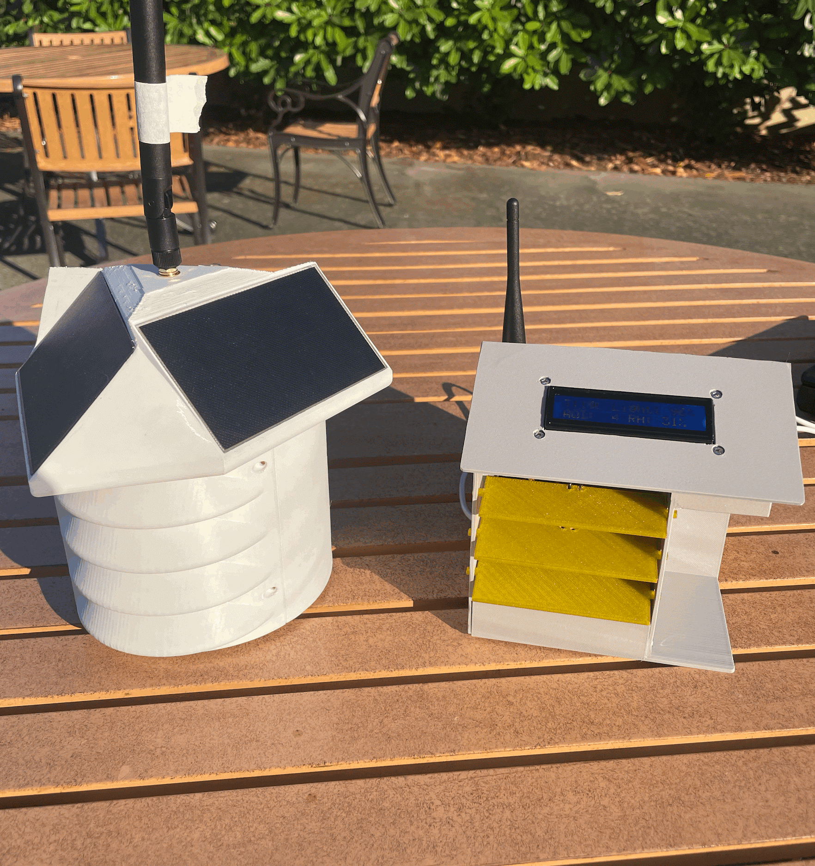
Weather Station & Smart Home
Ben Arnett
May 19, 2025

Slide 2
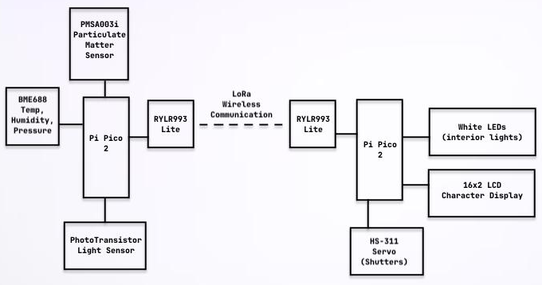
Project Description
What's it supposed to do?
A remote Weather Station intermittently measures and transmits real time weather data
A Smart Home receives that data and changes the “interior” climate controls automatically
Why I chose it:
Previously I had started playing around with LoRa
I wanted to develop a system using it that had real world applications
Internet of Things (IoT) experience

Slide 3
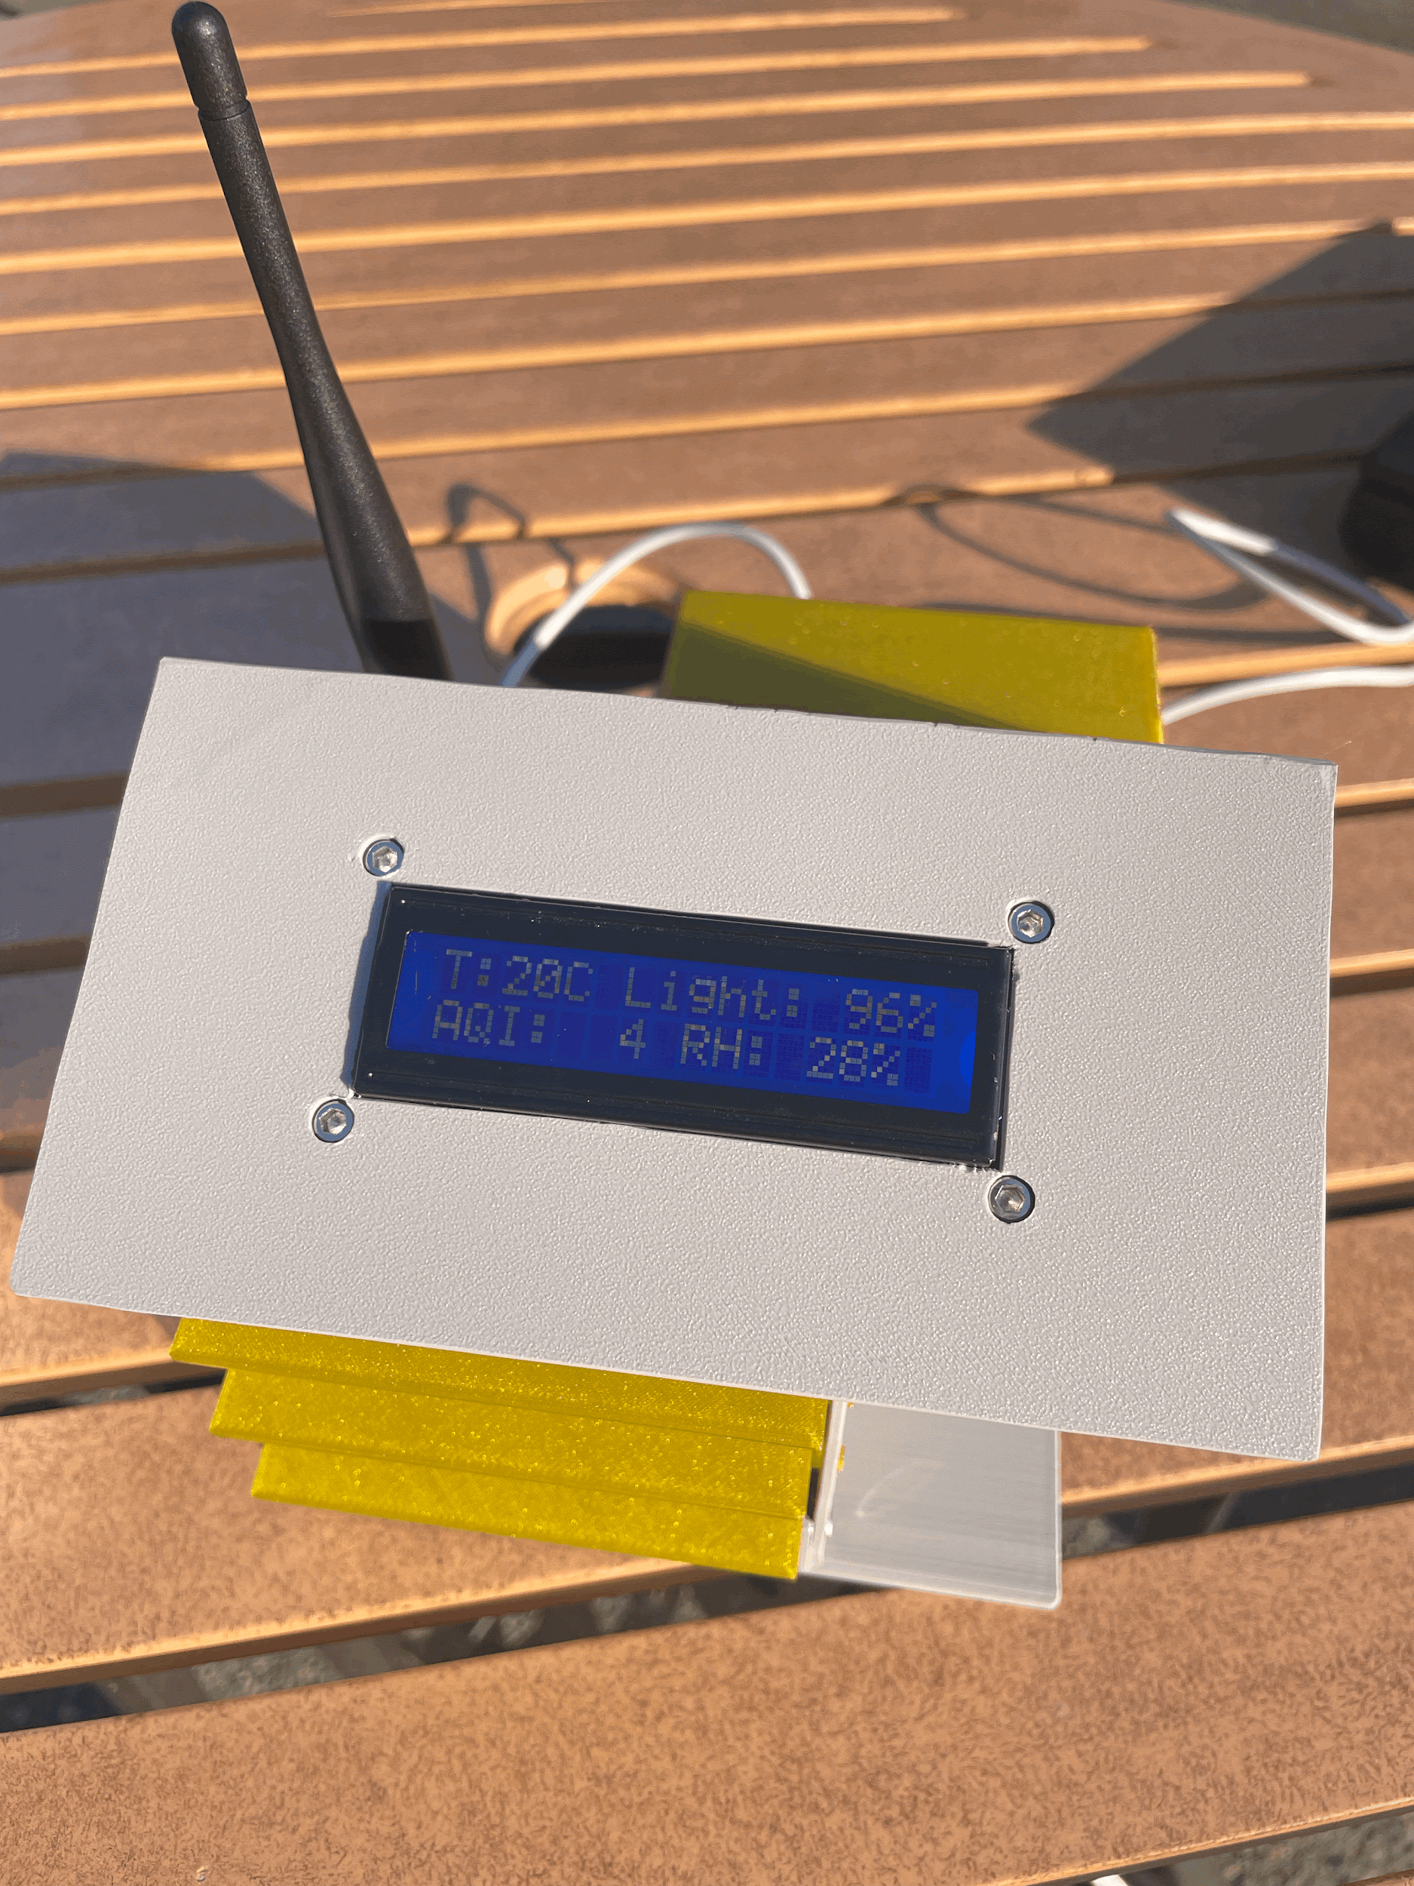
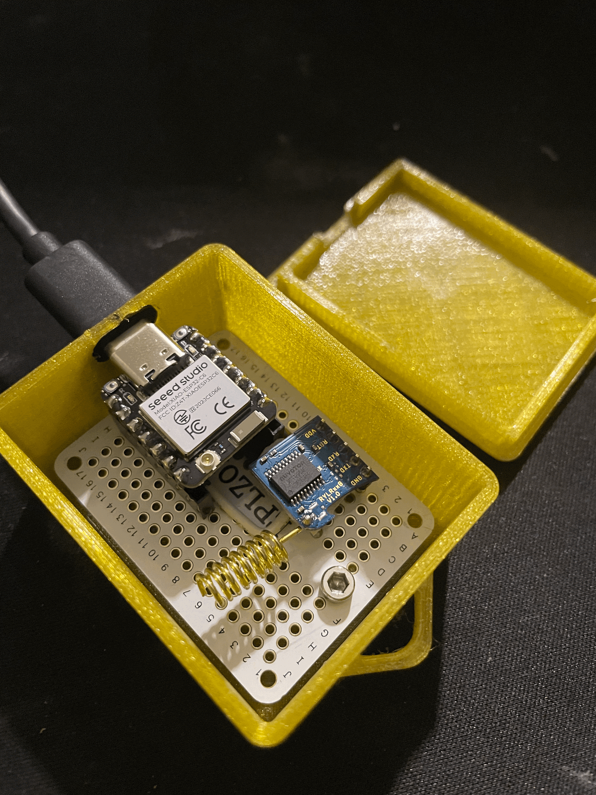
Demo
Smart Home power up sequence

Slide 4
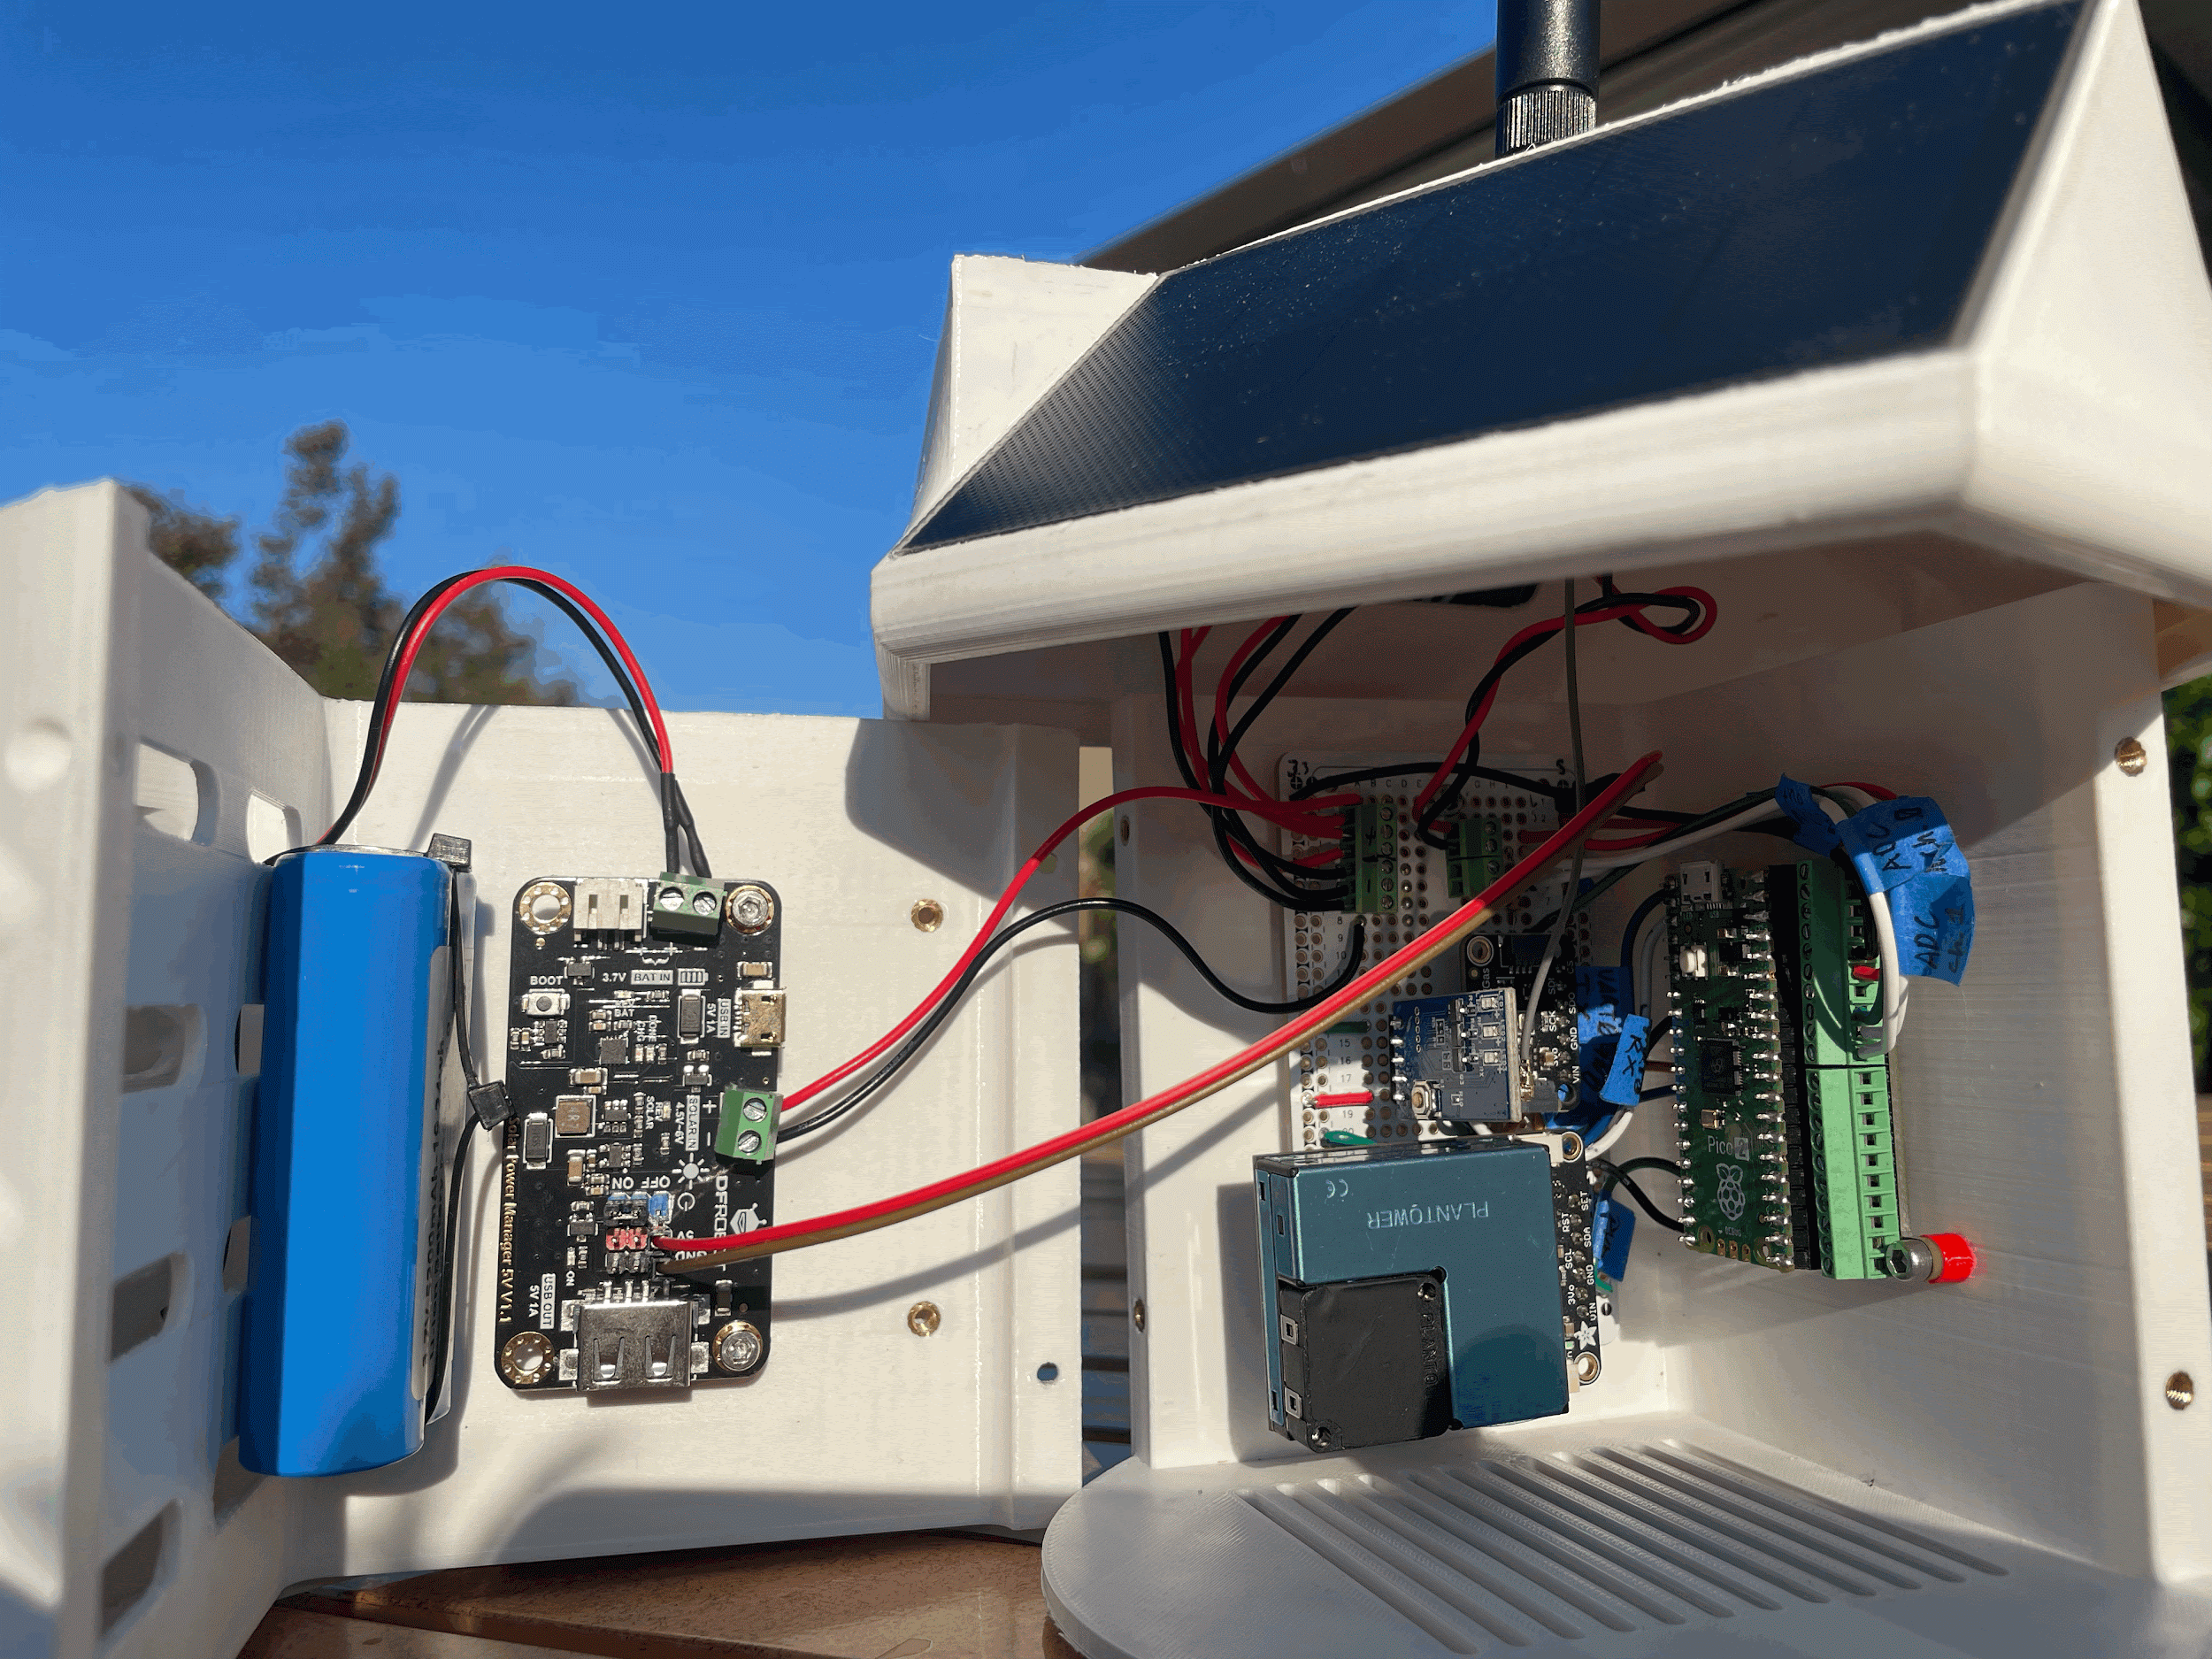
Guts

Slide 5
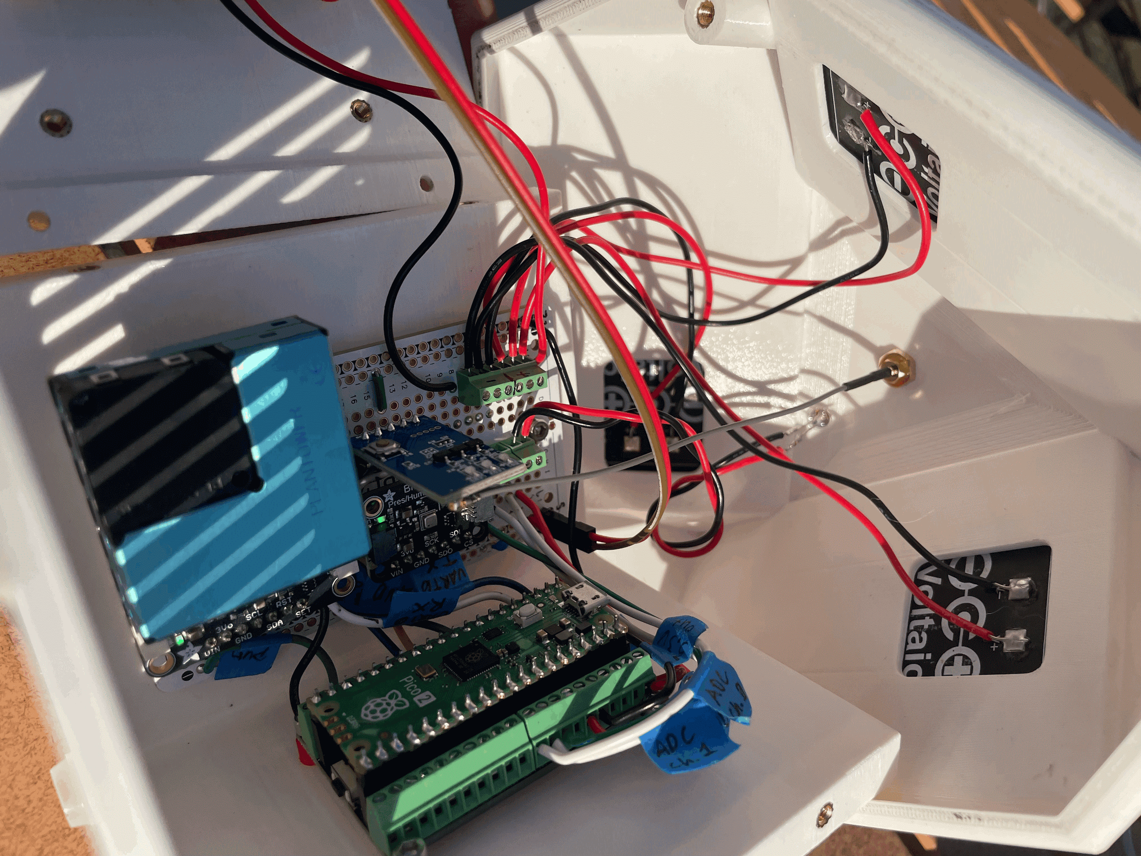

Slide 6
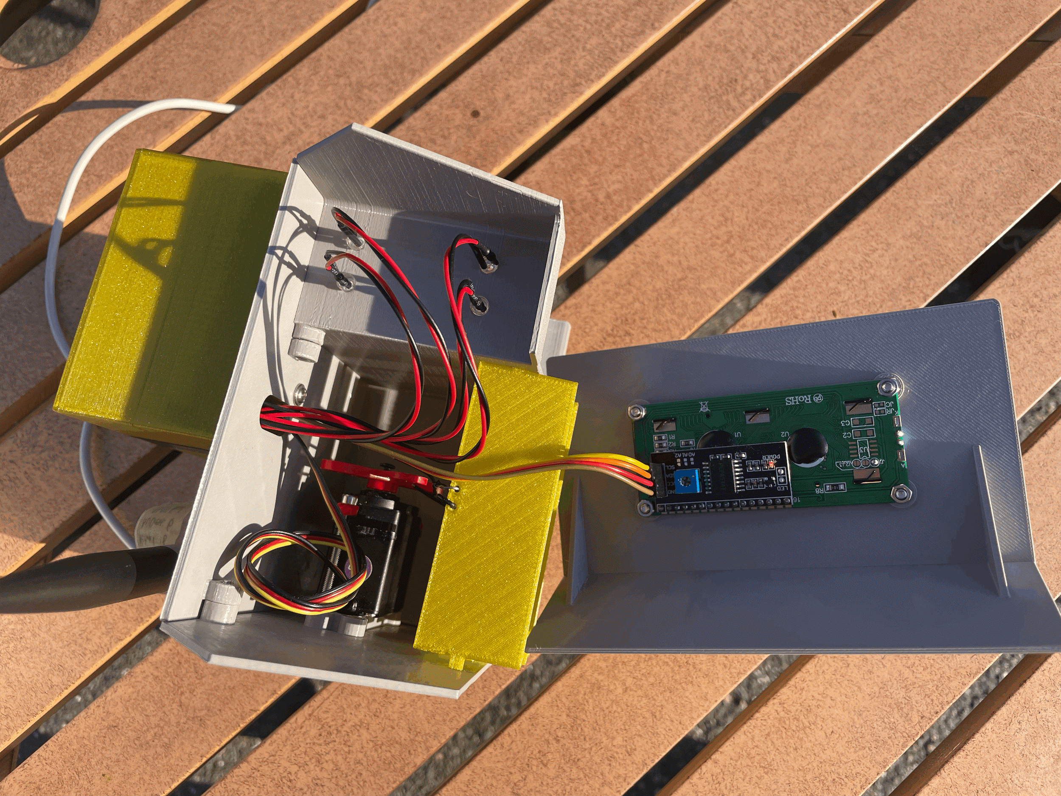

Slide 7
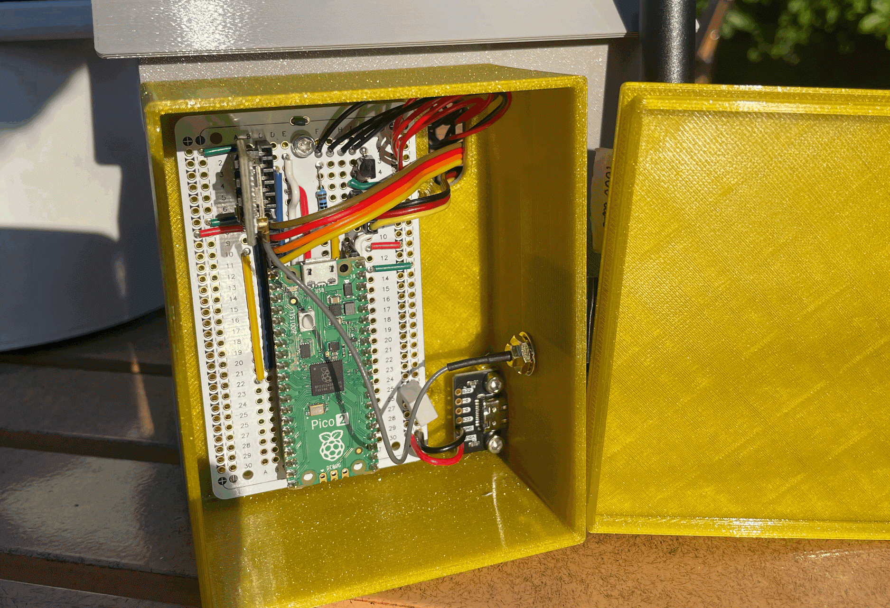

Slide 8
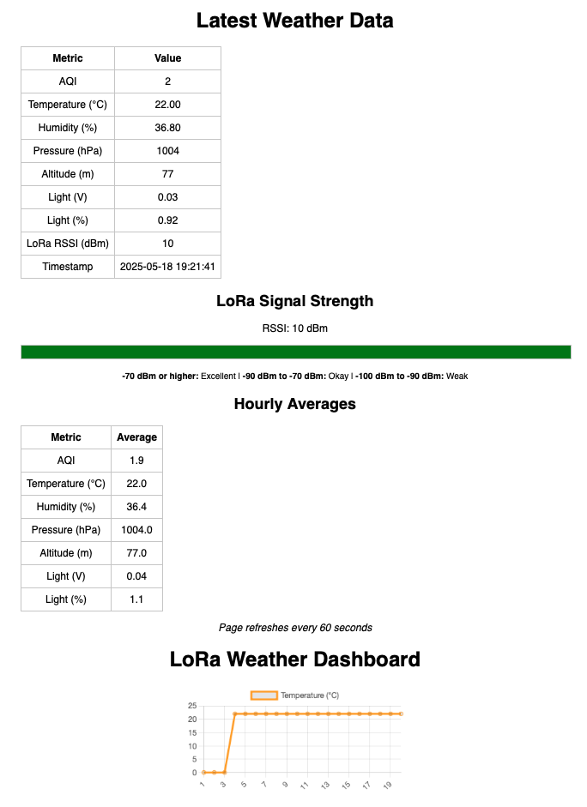

Slide 9
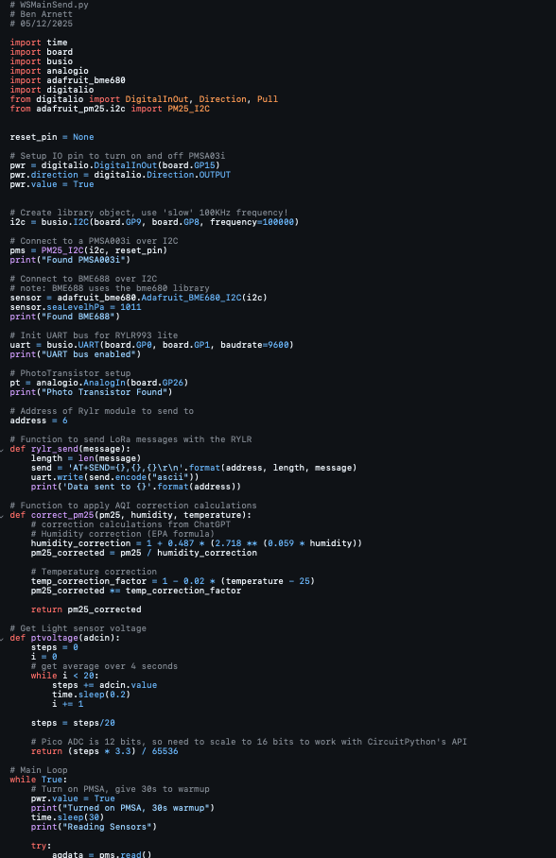

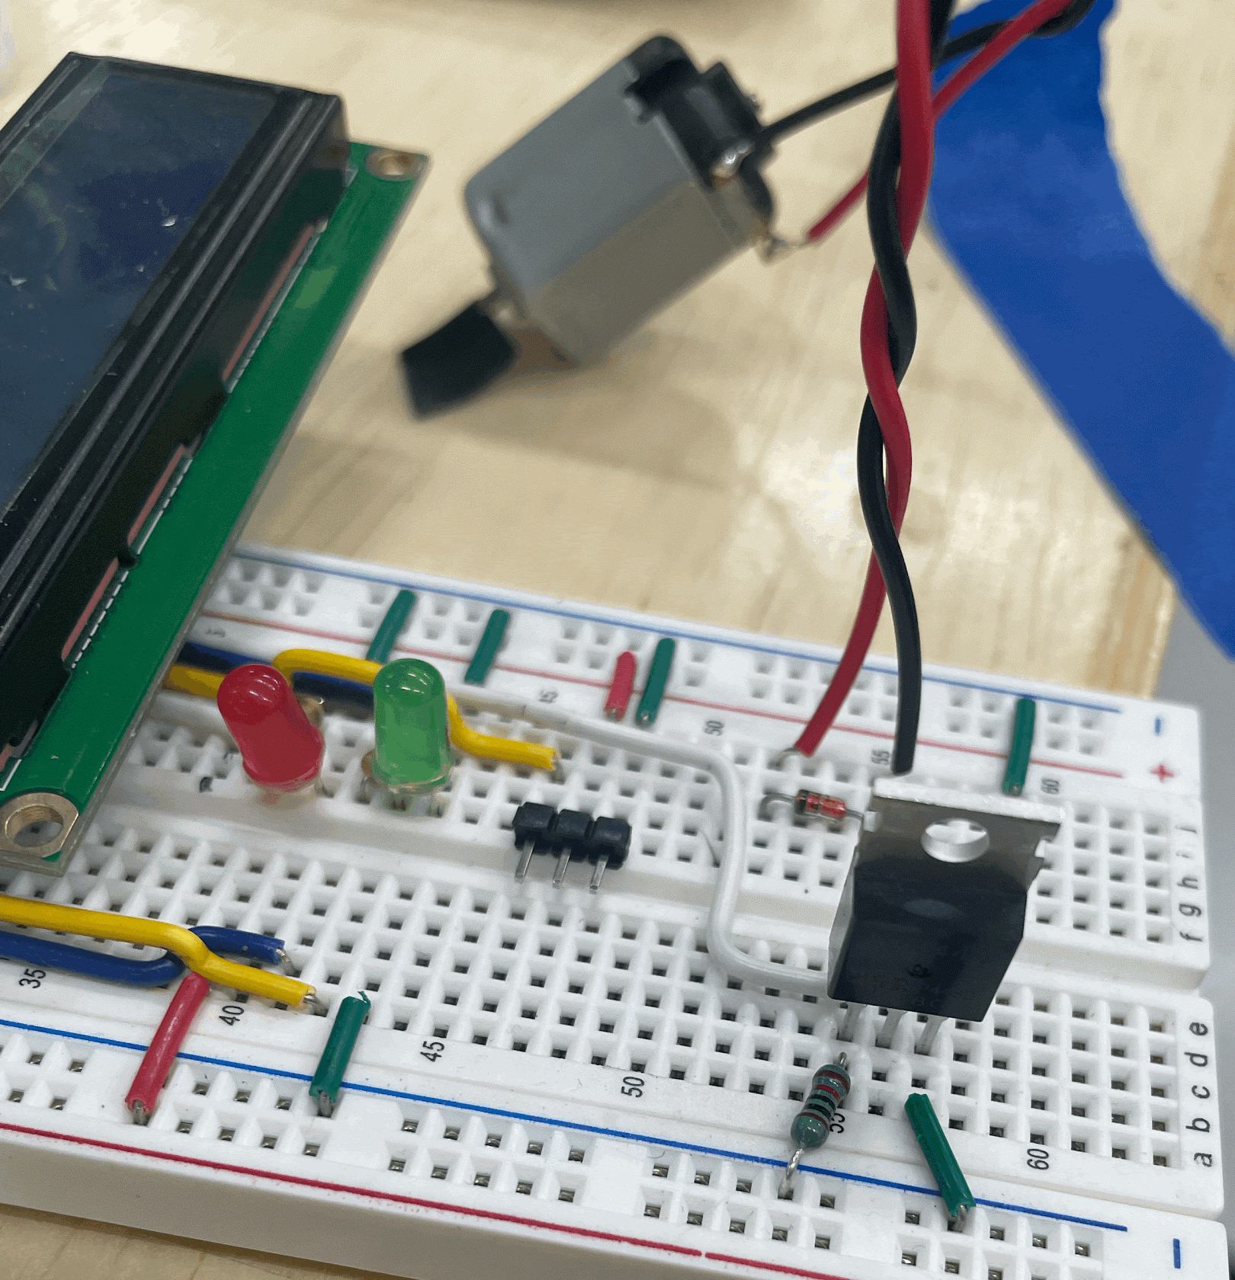
Challenges
Hardware:
Weather Station needed to be rain-proof while allowing airflow
Model House Power issues
Having two ‘subsystems’ made it feel like I was handling multiple projects
Software:
Learning CircuitPython & converting proofed MicroPython code
String manipulation, dictionaries
Overall completely different formulation then Basic on Picaxe
Some Python experience going into it helped

Slide 10


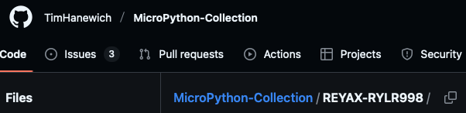
Liberated Code !
Tim Hanewich
-
RYLR998 module for MicroPython
Adafruit
-
Sensor Module CircuitPython Libraries
ChatGPT
-
Python data manipulation, AQI Correction

Slide 11
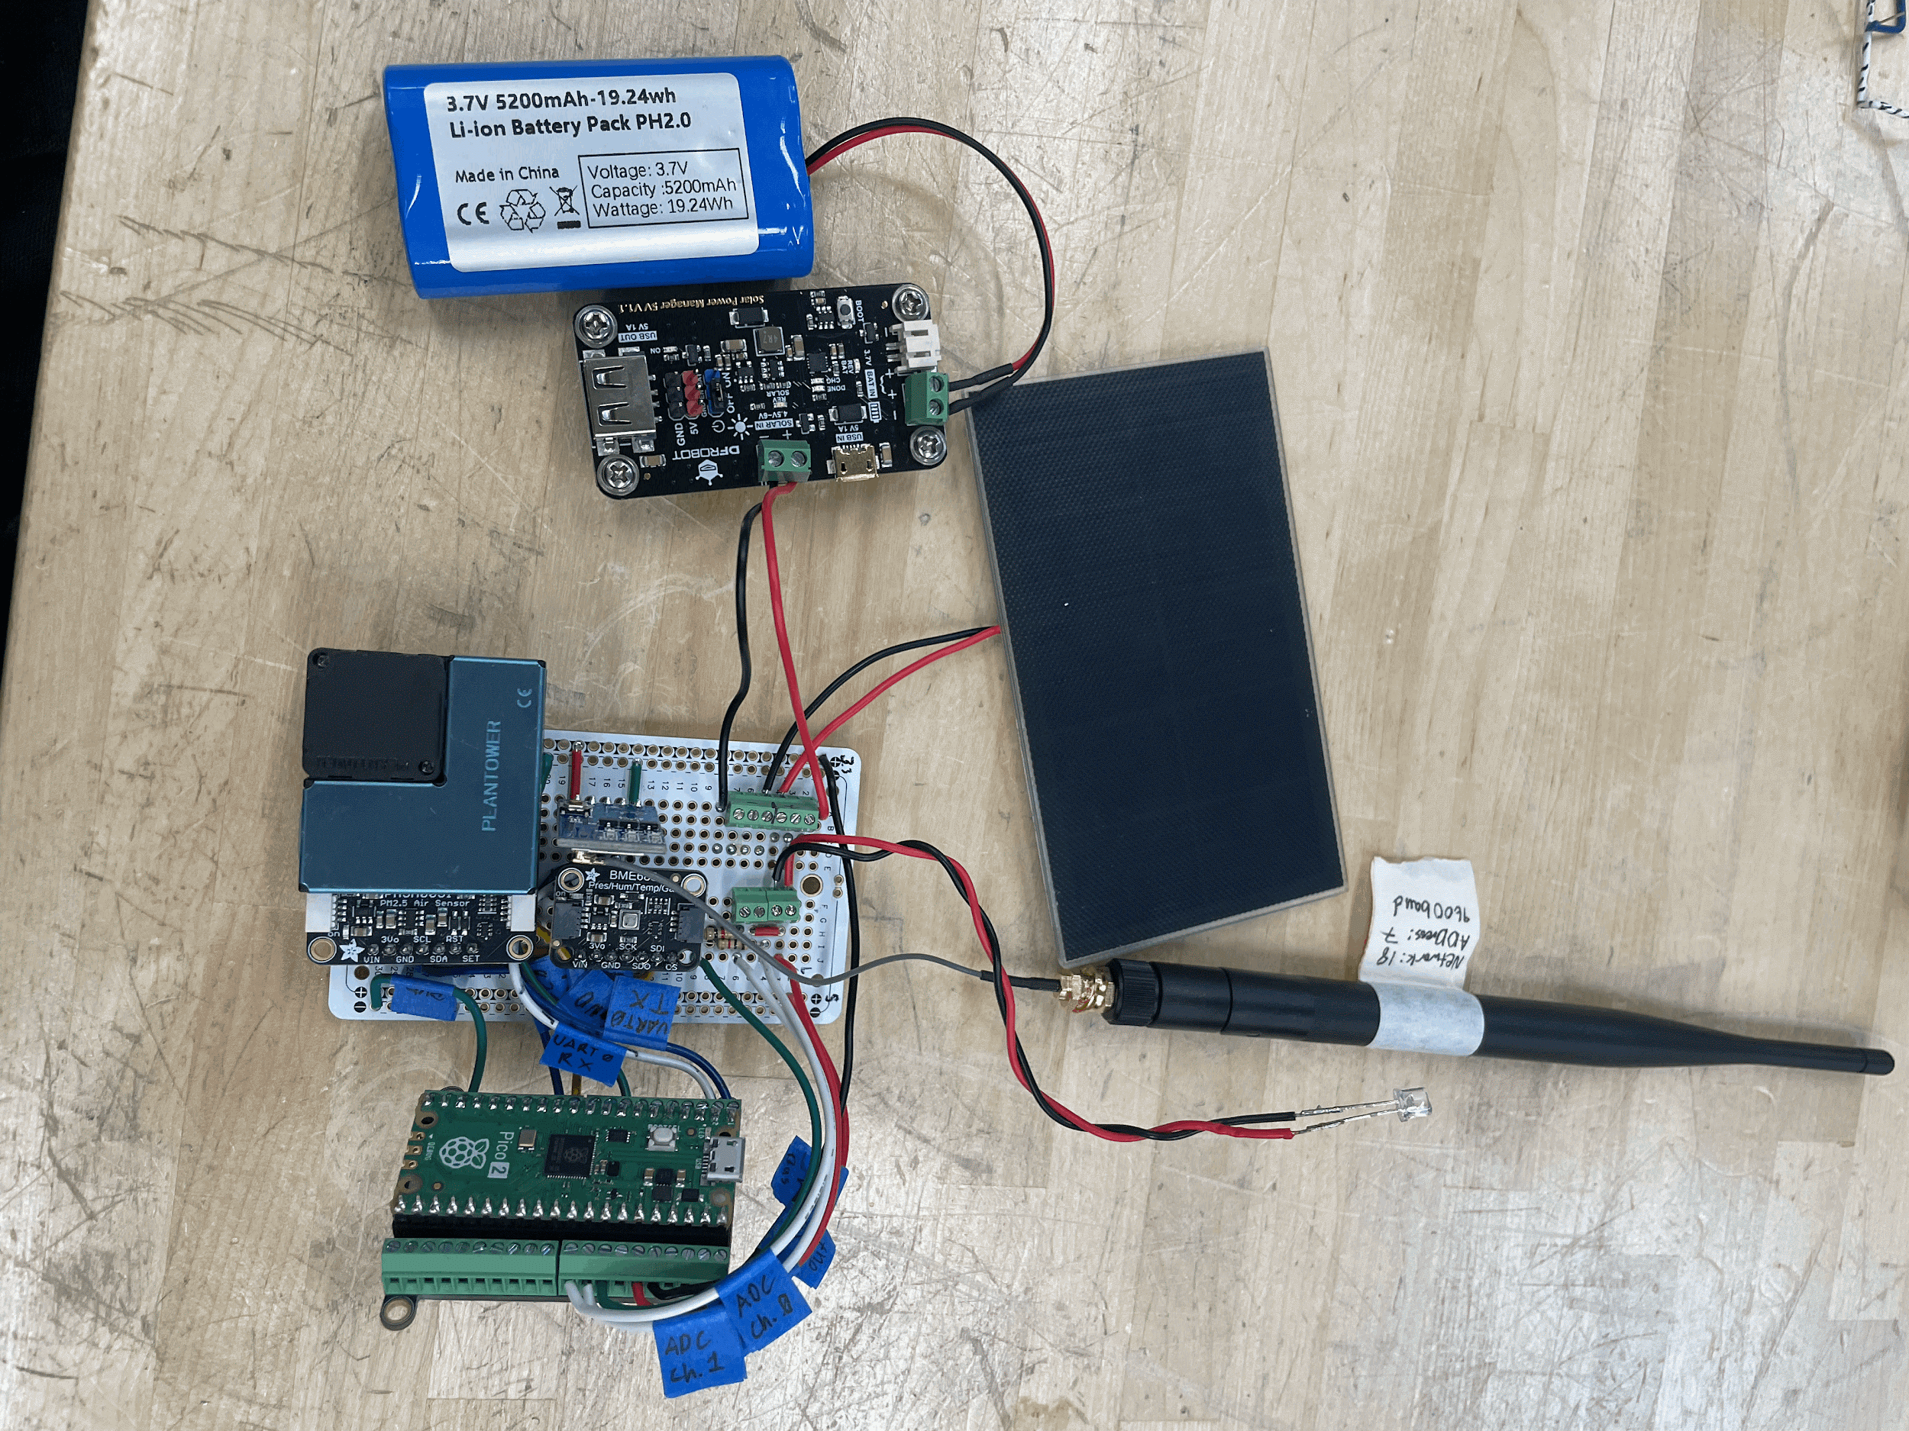
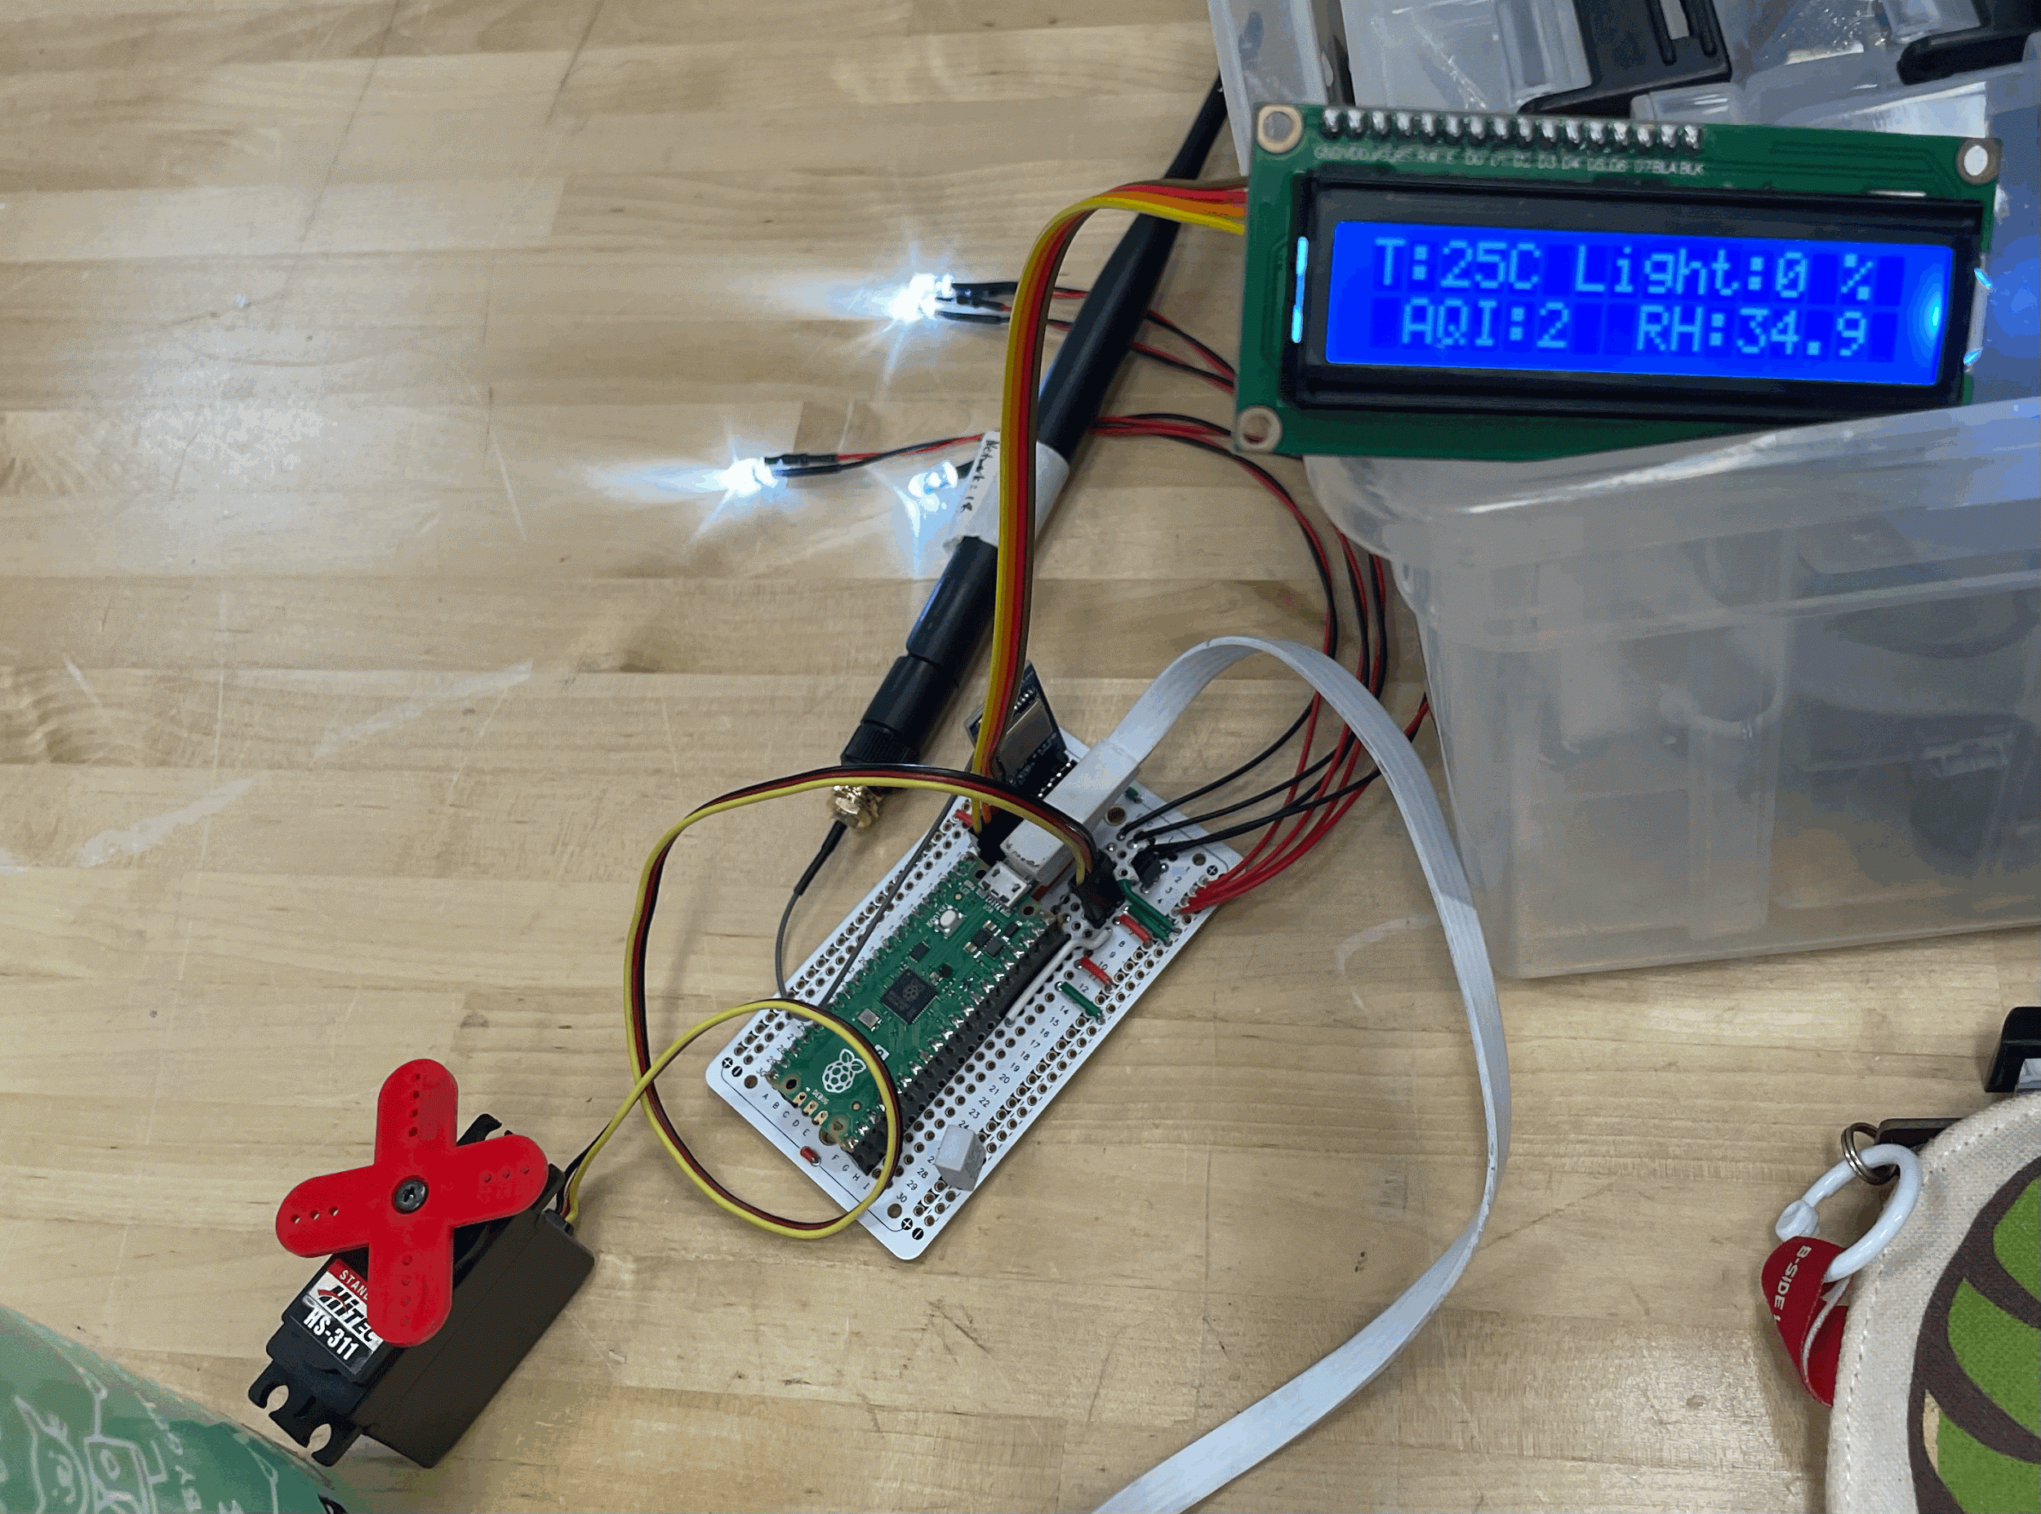
Cost with high level breakdown
Weather Station
(Unique components)
Smart Home
(Unique components)
Miscellaneous
(incl. Extra parts)
Tax,
Shipping
Actual
Total:
~$200
~$65
~$160
~$ 31
~$ 40
$496.26

Slide 12
Successes
Complete
Automation
Output Scaling
LoRa integration
Keychain LoRa receiver & network
Once powered on, both systems don’t need (or take!) any further human input
Instead of having a bunch of “if __ then __ elseif…” statements, sensor data is intelligently scaled into output values that make sense
(Light PWM,
Servo angle)
Upon some testing, measured ranges of about 1000 ft in urban environment (weak signal), and 1500 ft in rural (very strong signal but road ended)
While it wasn’t initially part of this project, it provides a great intro to network connection and website programming / network hosting

Slide 13
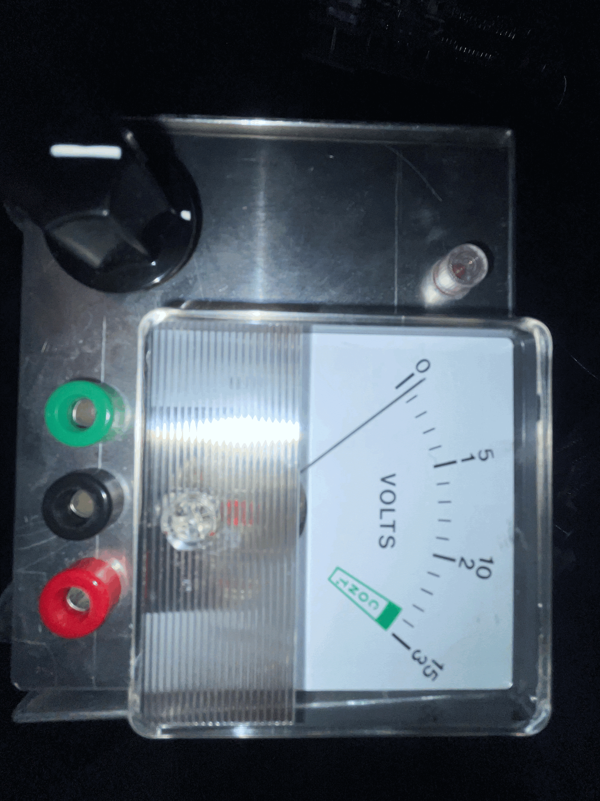
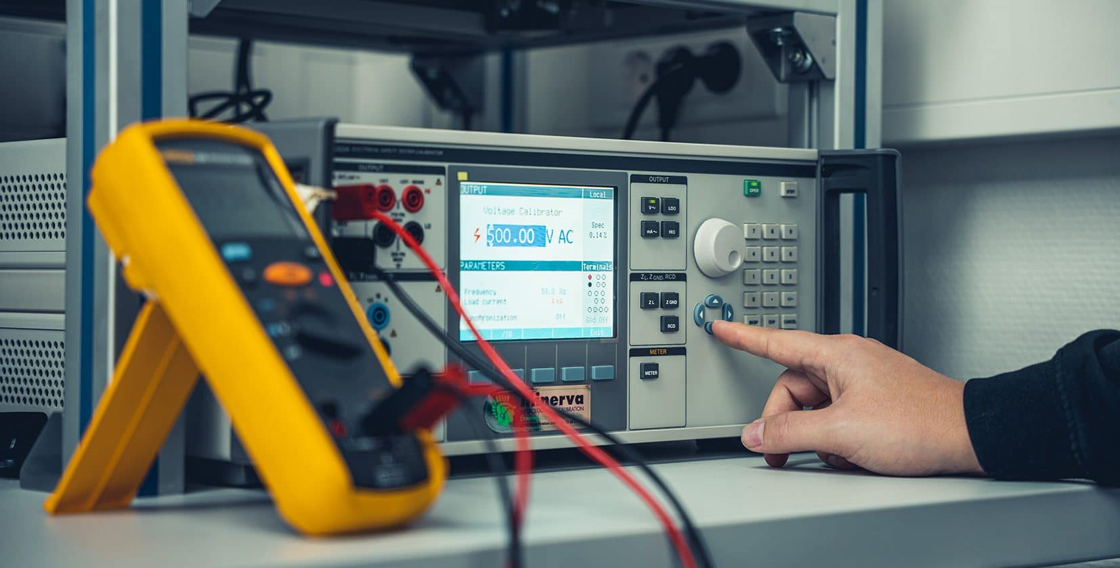

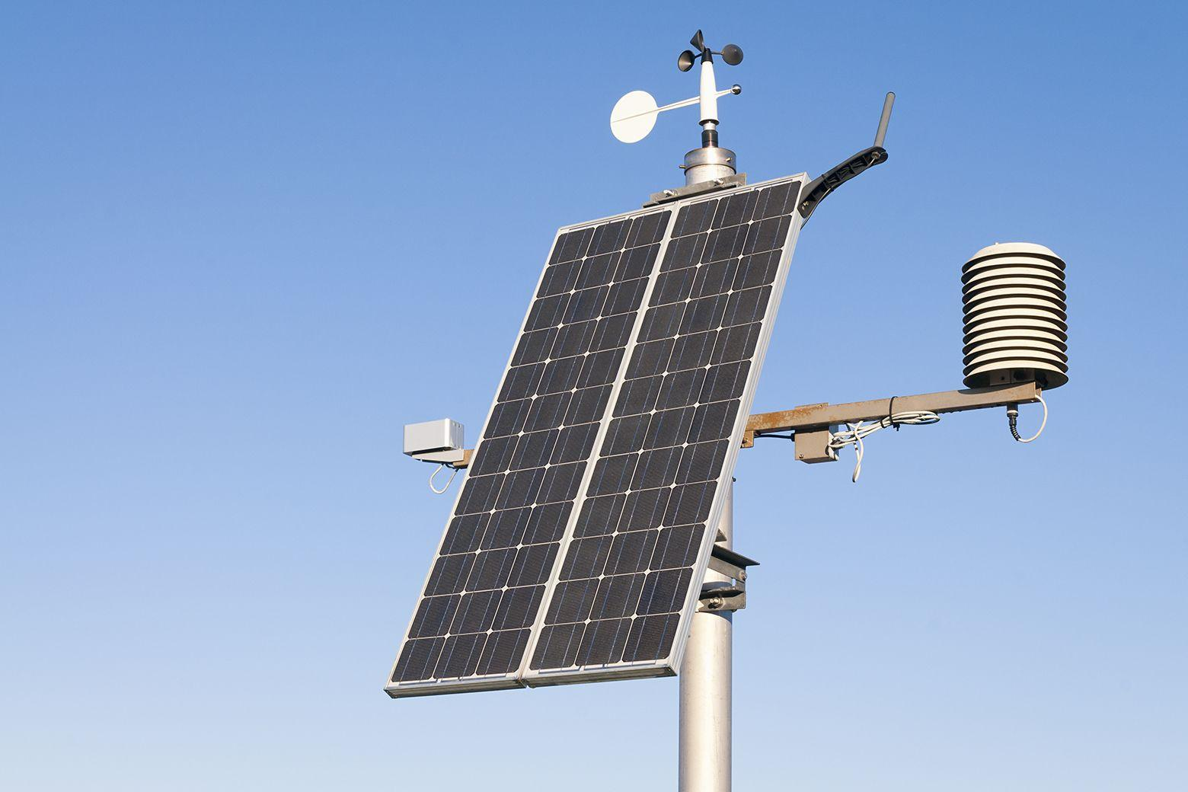

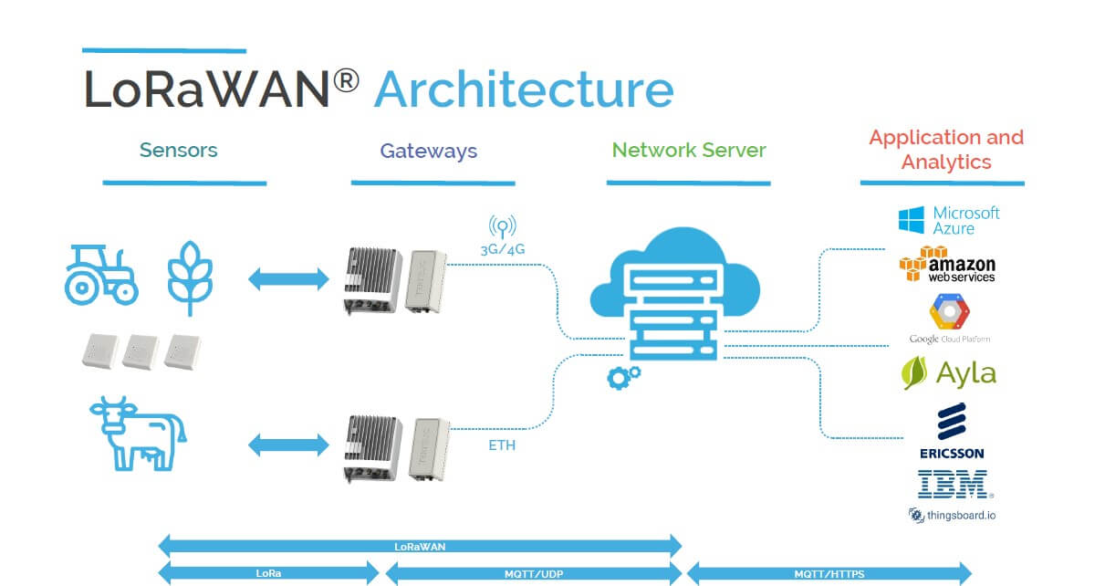
Areas for Improvement
Fix Smart Home power supply issues & add fan, manual changes
Weather Data Calibration
Manufacturing methods outside of 3D printing
Weather Station.
More R&D on the rain-proof, air-flow allowing design
Solar panel placement
Mounting system
Overall assembly & rigidity
Integrate with LoRaWAN for worldwide access

